Slide 1

Advanced x86: BIOS and System Management Mode Internals Trusted Computing Technologies
Xeno Kovah && Corey Kallenberg
LegbaCore, LLC

Slide 2
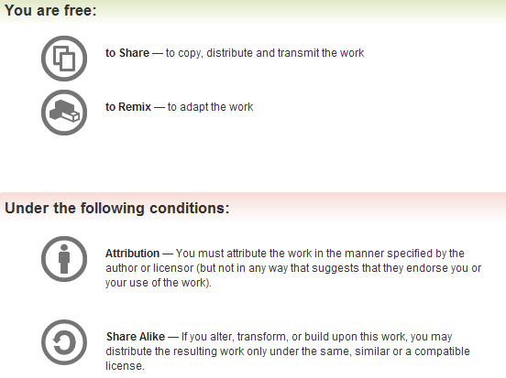
All materials are licensed under a Creative Commons “Share Alike” license.
http://creativecommons.org/licenses/by-sa/3.0/
Attribution condition: You must indicate that derivative work
"Is derived from John Butterworth & Xeno Kovah’s ’Advanced Intel x86: BIOS and SMM’ class posted at http://opensecuritytraining.info/IntroBIOS.html”
Notes:
Attribution condition: You must indicate that derivative work
"Is derived from John Butterworth & Xeno Kovah’s ’Advanced Intel x86: BIOS and SMM’ class posted at http://opensecuritytraining.info/IntroBIOS.html”

Slide 3
NOTE
There’s an entire 2 day class all about TPMs, and what they can and can’t do, here:
http://opensecuritytraining.info/IntroToTrustedComputing.html
(Why John chose not to reuse some of that material, I don’t know)

Slide 4
Motivation
“Secure Boot” does some sort of check on the integrity of components (such as a digital signature check) while booting up. If the check works, it continues.
So you basically have a situation where it’s either “
And as you saw, it can be bypassed
“Measured Boot” may allow the system to still boot even if an integrity violation occurs, but it allows integrity evidence to be collected and stored into a trustworthy location like the TPM
Information can then be sent back to an “appraisal” server (in a process known as “remote attestation”) for making the determination of whether a system is infected or not

Slide 5
How computers do measured boot
BIOS
(Basic Input/Output System)
Measure BIOS, Option ROMs, etc (before invocation)
Store to TPM
TPM
Measure boot loader (e.g. MBR)
Store measurement to TPM
Hand off to boot loader
Boot Loader
Boot loader measures OS/hypervisor before handing off
OS/hypervisor measures apps, etc
OS/Hypervisor
Applications

Slide 6
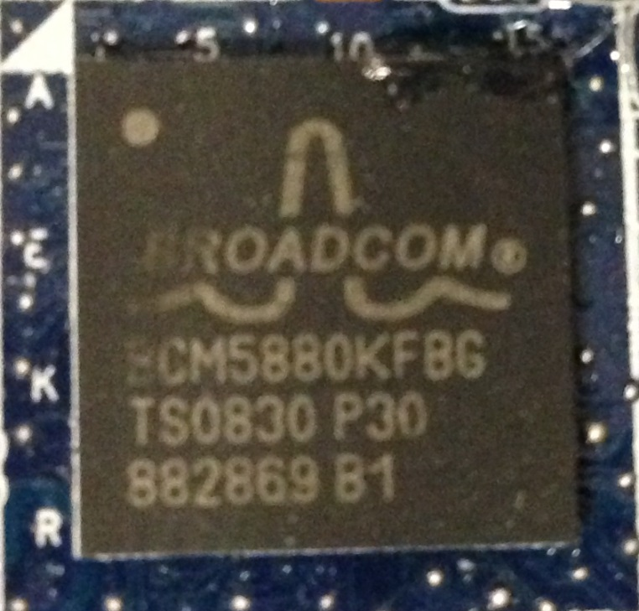
Trusted Platform Module* (TPM)
A physical chip soldered to the motherboard
There are logical/software TPMs, but not relevant to this course
And not a good idea
Passive chip. Programmed by applications (like the BIOS)
Created by a committee of companies and organization collectively called the Trusted Computing Group (TCG)
The goal of the TCG is to provide an architecture that implements Trusted Computing
Trusted Computing means that your system will behave as expected or at least be able to provide reports indicating that it might not be
The TPM chip on the E6400
*This is only a basic primer on TPM; just enough to understand the BIOS relation to the trusted computing technologies which the TPM provides. Also, this is all based on the 1.2 Specifications, since 2.0 is not finalized, and therefore hardware using it is not common yet.

Slide 7
TPM Functionality: Platform Integrity Reporting
A TPM has 3 basic functions:
Platform Integrity Reporting (aka: Root of Trust for Reporting)
Platform Authentication
Secure Storage
Platform Integrity Reporting is actually the only one that is really applicable to this class
Includes the measurement performed by the BIOS code (including UEFI)
Also includes the integrity reporting feature of the TPM to provide a snapshot of the measurement state
We’ll cover this topic in a bit
Notes:
It does not execute code.

Slide 8
TPM Functionality: Platform Authentication
A TPM has 3 basic functions:
Platform Integrity Reporting (aka: Root of Trust for Reporting)
Platform Authentication
Secure Storage
Platform Authentication refers to creating Authentication Identity Keys (AIK)
Used to sign PCR quotes
Notes:
It does not execute code.

Slide 9
TPM Functionality: Secure Storage
A TPM has 3 basic functions:
Platform Integrity Reporting (aka: Root of Trust for Reporting)
Platform Authentication
Secure Storage
Secure Storage provides two functions:
Binding – Encrypts data. Data can be encrypted with a migratable key so that it is bound to a specific TPM/platform or it can be encrypted with a migratable key so that the data can be migrated to another system. Caller provides the valid key to decrypt.
Sealing – Encrypts data (keys, etc.) so that it will only be decrypted when the system PCRs are in a particular state. Sealed data must be encrypted with non-migratable keys so the data encrypted is bound to the platform/TPM.
Microsoft BitLocker uses the TPM Secure Storage Sealing feature
Notes:
It does not execute code.

Slide 10
TPM Key Types
Endorsement Key
Permanently embedded in the TPM hardware at the time of manufacture
The private part of the Endorsement Key is never released outside of the TPM
Can be used to verify that software is communicating with an actual TPM (as opposed to a malicious software application pretending to be a TPM)
Storage Root Key
Created when the TPM is initialized by software
Used to encrypt/decrypt keys created by an application so that they can be stored outside the TPM
Embedded in the TPM hardware, can be overwritten if the TPM is cleared and re-initialized
Notes:
It does not execute code.

Slide 11
TPM Key Types
Migratable Keys
Can be migrated to another TPM/platform
Non-Migratable Keys
Stored within the TPM shielded storage
Cannot be migrated to another platform/TPM
Attestation Identity Keys (AIK)
Non-migratable keys
Used to sign "quotes" of PCR values when requested by an application
Therefore the main key we often care about for “remote attestation”
Notes:
It does not execute code.

Slide 12
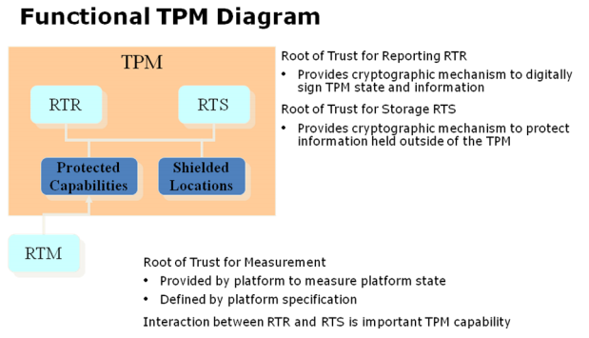
TPM Components
PCRs
Implemented
by the BIOS
developer
Base diagram from
http://www.intel.com/content/dam/doc/white-paper/uefi-pi-tcg-firmware-white-paper.pdf
Notes:
http://www.intel.com/content/dam/doc/white-paper/uefi-pi-tcg-firmware-white-paper.pdf

Slide 13
Platform Integrity Reporting
This functionality combines what is called (in TPM-land) the Root of Trust for Reporting (RTR) and the Root of Trust for Measurement (RTM)
Per TCG: “The RTM is a computing engine capable of making inherently reliable integrity measurements.*”
The code that performs the measurements are implemented outside the TPM (as shown in the previous slide)
By the BIOS, for example.
There are two types of RTMs, Dynamic and Static.
Dynamic means that trust is established after the operating system has booted. Trust is established even when the system booted in an insecure state
Intel’s Trusted Execution Technology (TXT) uses DRTM
TXT is an entire course unto itself which Xeno is preparing
www.invisiblethingslab.com/resources/2011/Attacking_Intel_TXT_via_SINIT_hijacking.pdf
*ISO/IEC 11889-1 Information Technology Trusted Platform Module, Pt.1

Slide 14
Static Root of Trust for Measurement* (SRTM)
Also called Measured Boot (Not to be confused with Secure Boot, that’s a different entity discussed in the UEFI portion)
General idea is that the next component of the boot sequence is measured before control is handed off to it
Thus forms a “chain of trust” where each component has been measured before it executes
“Static” refers to the idea that the same components are measured each time and that their measured values should not change
Begins life in the BIOS so its implementation is thus the responsibility of the vendor
The first of these measurements is called the Core Root of Trust for Measurement (CRTM)
*Often referred to as S-CRTM, Static-Core RTM

Slide 15
Core Root of Trust for Measurement (CRTM)
Whereas it’s said the SRTM forms a “chain of trust”, the CRTM forms the “anchor”
CRTM is responsible for measuring the next component in the boot sequence (next link in the chain)
Being part of the overall SRTM, it always begins life in the BIOS
As a guideline, CRTM should perform its measurements as soon as possible (start establishing trust sooner than later)
According to the TCG, the “TPM and CRTM are the only trusted components on the Motherboard” (TCG PC Client Specification for Conventional BIOS)

Slide 16
Measured Boot ("measured boot" != UEFI "secure boot")
Master Boot Record
Partition Table
Peripheral's
option/expansion ROMs code
Config
Peripheral's
option/expansion ROMs code
Config
Peripheral's
option/expansion ROMs code
Config
Measure 4
Measure 5
Measure 2
Measure 3
BIOS code on flash chip
Core Root of Trust for Measurement
(CRTM)
Measure 1
BIOS configuration
in non-volatile RAM ("nvram"/"CMOS")
Measure 0
…
Extend PCR0
Extend PCR5
Extend PCR1
Extend PCR2
Extend PCR3
Extend PCR4
Trusted Platform Module (TPM)
This collection of measurements going forward is the
Static Root of Trust for Measurement (SRTM)

Slide 17
CRTM (im)Mutability
“The Core Root of Trust for Measurement (CRTM) MUST be an immutable portion of the Host Platform’s initialization code that executes upon a Host Platform Reset”
“immutable means that in order to maintain trust in the Host Platform, the replacement or modification of code or data MUST be performed by a Host Platform manufacturer-approved agent and method.”*
Basically they are telling vendors that they know the CRTM will be implemented on mutable flash hardware, but that they will be in compliance as long as its only their code that ever changes it.
That works great until it doesn’t…
*TCG PC Client Implementation for BIOS
Notes:
Captain Obvious says well duh this works great until all of a sudden it doesn’t
Maybe find this in the

Slide 18
Platform Configuration Registers (PCRs)
The measurements of each component are stored on the TPM in registers
There are at least 16 PCRs on a TPM, each 20 bytes long
Initialized to 0 each time the platform is reset
Can only be modified by an extend function
PCR[n] = SHA-1 ( PCR[n] || measured data )
where || denotes concatenation
So basically, each PCR represents the state of one or more boot components (at the time of measurement)
Each boot component is represented as a SHA-1 hash

Slide 19
PCR Standard Usage
PCR | Use
0 | S-CRTM, BIOS, Host Platform Extensions, and Embedded Option ROMs
1 | Host Platform (Motherboard) Configuration
2 | Option ROM code
3 | Option ROM Configuration and Data
4 | IPL Code (usually the MBR) and Boot Attempts
5 | IPL Code Configuration and Data
6 | Power State Transition (sleep, hibernate, etc.)
7 | Defined by OEM
8-15 | Unassigned
Each PCR is intended to store a different measured component, defined by TCG
The implementation is actually up to the vendor
IPL = Initial Program Loader, typically the Master Boot Record (MBR)

Slide 20
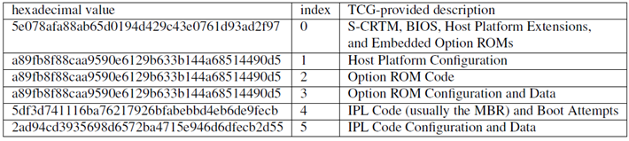
General Problems with PCR Hashes
Opaqueness
Generally no golden set of PCRs is provided by the OEM.
Some vendors like HP have started to finally provide this! Yay!
No description of what is actually being measured and incorporated into the PCR values.¹
“Homogeneous” systems can have different PCR values.²
Duplicate PCR values are unexpected if they're measuring different data…
Example E6400 PCR Set:
The TCG specification gives vague guidelines on what should be incorporated into individual PCR values, and many decisions are left to the vendor.
Based on our own observation of PCR values across various systems.
Notes:
Make sure you say the TCG-provided description is not actually accurate to what's actually being measured, and then point out that 1,2,3 are just hashes of 0
ASDF

Slide 21
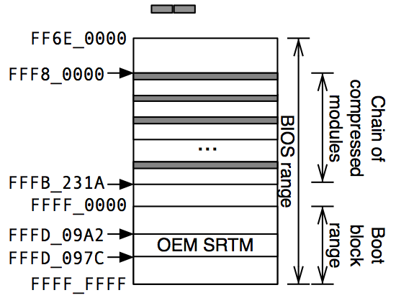
E6400 PCR0 (CRTM) Measurement
*
PCR0 should contain a measurement of the CRTM and other parts of the BIOS.
In the above diagram, the dark areas represent what the E6400 actually incorporates into the PCR0 measurement.
Only 0xA90 of the total 0x1A0000 bytes (.15%) in the BIOS range are incorporated, including:
The first 64 bytes of the 42 compressed modules.
Two 8 byte slices at 0xDF4513C0 and 0xDF4513C7.
The CRTM is not incorporated at all.
*Typo in image: BIOS Base on the E6400 is located at FFE6_0000h
Notes:
Will need to caveat that there is a size field in the first 64 bytes. We should

Slide 22
Implications of the weak SRTM
Measurements for things like PCI option ROMs and BIOS configuration are not actually captured.
We can modify the majority of the E6400 BIOS without changing any of the PCR values.
Yuriy Bulygin presented a similar discovery at CanSecWest 2013 regarding his ASUS P8P67
"Evil Maid Just Got Angrier: Why Full-Disk Encryption With TPM is Insecure on Many Systems" – Yuriy Bulygin – March 2013 http://cansecwest.com/slides/2013/Evil%20Maid%20Just%20Got%20Angrier.pdf
As long as the Flash can be modified, the measurement code which executes from the flash can be modified to report false negatives
Let’s take a look at some weaknesses that come along with a S-CRTM that provides incomplete coverage

Slide 23
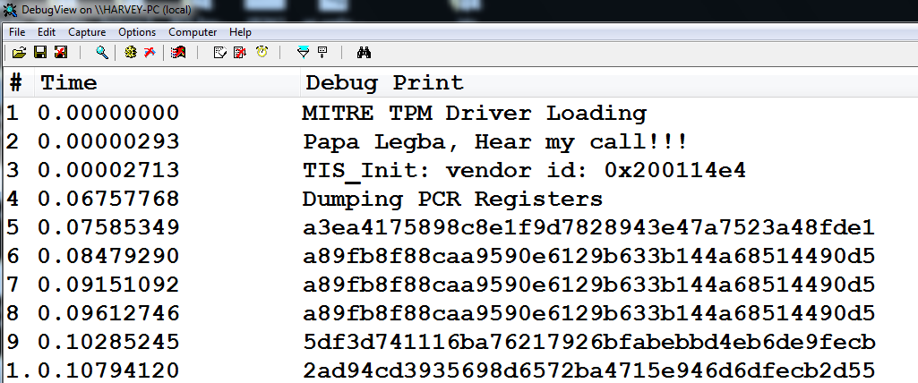
Reading PCRs with OpenTPM
Corey Kallenberg wrote OpenTPM which queries and dumps the PCR register set
Open source: https://code.google.com/p/opentpm/
Activate/enable your TPM in your BIOS settings to use it

Slide 24
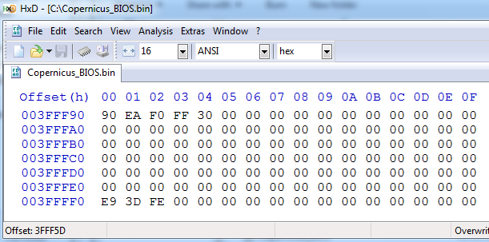
vulnBIOS Example: Incomplete S-CRTM Coverage
Either view your existing BIOS dump or make a new one using Copernicus
Open in HxD and skip to the end (entry vector)
Notice bytes 3F_FFFB – 3F_FFFE are 0h

Slide 25
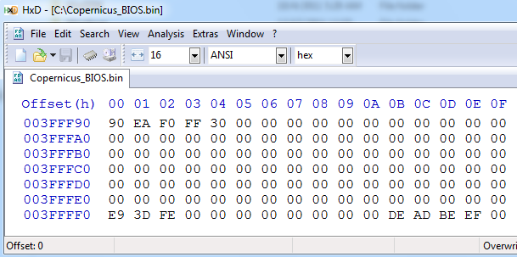
vulnBIOS Example: Incomplete S-CRTM Coverage
This will only run on E6400 systems!
Execute the ‘tpm_spi_write_no_change_pcr.sys’ driver
This writes DEADBEEFh as you can see (in this case, on this system, this does not prevent the system from booting, YMMV!!!)
Reboot

Slide 26
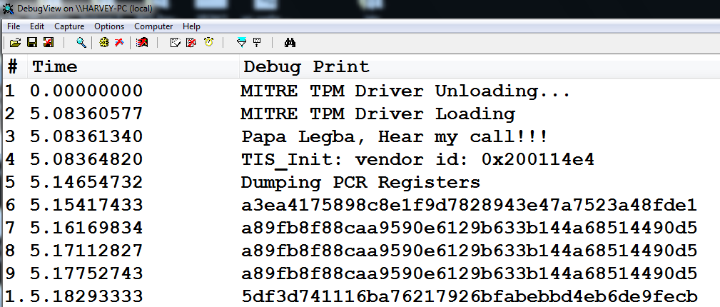
vulnBIOS Example: Incomplete S-CRTM Coverage
After rebooting the system,
Required because the BIOS has to re-run the measured boot process and re-populate the PCRs
Re-run the OpenTPM driver
Notice in particular PCR0 is the same (they are all the same)
So an attacker can modify big chunks of the BIOS without triggering a change to PCR0!
But wait – it gets worse!

Slide 27
The Real Weakness: Mutable CRTM
*
Still weak; assuming the attacker can get into SMRAM or overwrite the flash either by exploiting a code vulnerability or misconfigured system
Don’t let the sparse measurement coverage in the previous slide distract you from the real issue – it is a red herring!
What *really* makes the S-CRTM weak is the fact that the CRTM is implemented on mutable flash hardware (the BIOS)
As we’ve seen, it can be trivial to overwrite the BIOS flash
An attacker who identifies the part of the BIOS that performs the CRTM measurement can simply overwrite it and therefore control it
It doesn’t matter even if the ENTIRE BIOS is being measured
The attacker may just have to work a little harder
Notes:
Will need to caveat that there is a size field in the first 64 bytes. We should

Slide 28
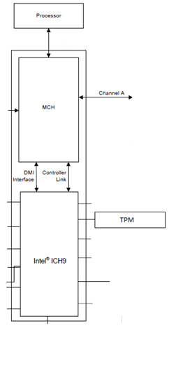
Normal BIOS PCR0 Measurement
0
4GB
System RAM
PCR0=SHA1(0₂₀ | 0xf005b411…)
BIOS
PCR_Extend(0xf005b411…)
SHA1(self)
SPI Flash
0xf005b411…
Notes:
Wasn’t this covered in the E6400 boot process slide? Perhaps a reminder? :/

Slide 29

PCR0 Measurement with a Tick
0
4GB
System RAM
PCR0=SHA1(0₂₀ | 0xf005b411…)
BIOS
SHA1(self)
PCR_Extend (0xf005b411…)
SPI Flash
Notes:
And just say here that the tick can also keep a compressed copy of the BIOS image that he decompresses and measures
The tick from http://th04.deviantart.net/fs6/PRE/i/2005/087/1/b/The_Tick_by_emucoupons.png

Slide 30
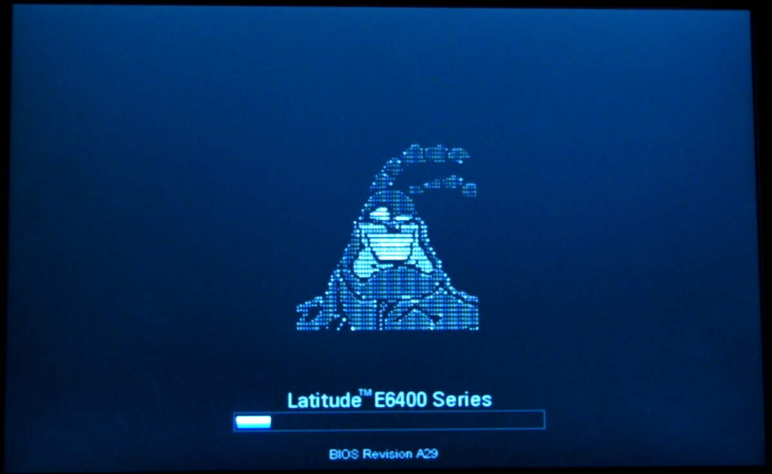
Mutable S-CRTM Problem
But actually, if the attacker can write to the BIOS, they can modify any/all of the BIOS regardless of whether its being measured and simply forge the PCR values
http://www.youtube.com/watch?v=S0lRcm3jvFo

Slide 31
Quick Diversion: RW Everything Scripting
RW Everything is a good tool for gathering all kinds of information about the system
It has a scripting interface and a good command set so it’s good for prototyping commands that touch bare-metal without writing a kernel driver (assuming windows, if Linux then just IOPL your way to Ring0 bliss)
Just be wary of syntax and expect a kernel crash now and then if you make a mistake
I’ve found that 64-bit Windows is more sensitive to RWE-related crashing
This lab serves to show you some of RWE’s scripting capabilities and how to use it for quick testing of ideas

Slide 32
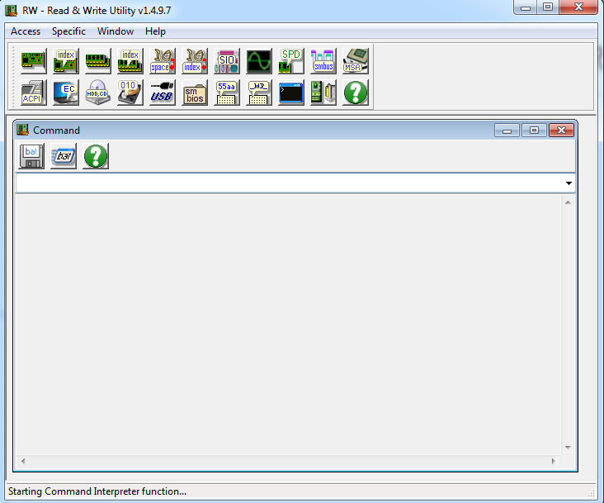
Use RW-E Scripting to Read a PCR
Open RW Everything
Click on the CMD icon

Slide 33
Use RW-E Scripting to Read a PCR
On your Desktop find the file named “ReadPCR0.rw”
The file contents are on the next slide in case you have to enter it by hand or don’t want to do the lab but just see what features RW Everything offers

Slide 34
RW Everything Commands
# This is the PCR Command Blob
>W 0xfed40000 0x20
>W 0xfed40000 0x02
>W 0xfed40018 0x40
>W 0xfed40024 0x00
>W 0xfed40024 0xc1
>W 0xfed40024 0x00
>W 0xfed40024 0x00
>W 0xfed40024 0x00
>W 0xfed40024 0x0e
>W 0xfed40024 0x00
>W 0xfed40024 0x00
>W 0xfed40024 0x00
>W 0xfed40024 0x15
>W 0xfed40024 0x00
>W 0xfed40024 0x00
>W 0xfed40024 0x00
# THIS IS THE # PCR YOU WANT TO READ (0-16 OR WHATEVER)
>W 0xfed40024 0x00
>W 0xfed40018 0x20
# ok now read the PCR:
>R 0xfed40024
>R 0xfed40024
>R 0xfed40024
>R 0xfed40024
>R 0xfed40024
>R 0xfed40024
>R 0xfed40024
>R 0xfed40024
>R 0xfed40024
>R 0xfed40024
>R 0xfed40024
>R 0xfed40024
>R 0xfed40024
>R 0xfed40024
>R 0xfed40024
>R 0xfed40024
>R 0xfed40024
>R 0xfed40024
>R 0xfed40024
>R 0xfed40024
>R 0xfed40024
>R 0xfed40024
>R 0xfed40024
>R 0xfed40024
>R 0xfed40024
>R 0xfed40024
>R 0xfed40024
>R 0xfed40024
>R 0xfed40024
>R 0xfed40024
MMIO to the memory address range reserved for TPMs
Commands in ReadPCR0 are on the left
Be wary of syntax!
W 0xFED4000 0x20
Writes a Byte to 0xFED4000 (physical address)
W16 will write a Word
W32 will write a DWord
R 0xFED40024
Reads a Byte from physical address 0xFED40024
Yes it’s ugly but can still be leveraged to save you time to test a PoC
Change this one to
read a different PCR
(0 - N)
Note how we just keep reading the same data location and will keep getting back different data

Slide 35
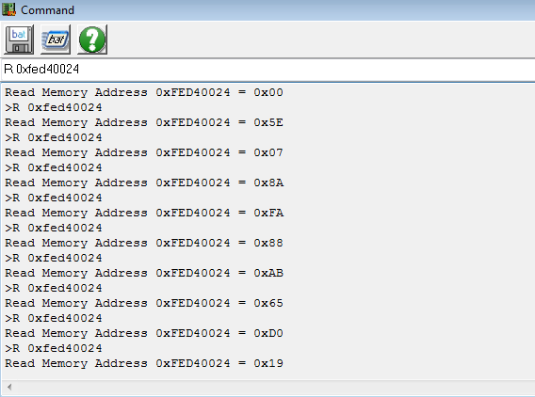
Use RW Everything to Read a PCR
If OpenTPM works on your system, then this will too
Output is a bit verbose, but the PCR value will be in there after the header
I couldn’t expand the output window to capture the whole PCR for the screenshot
But still good for prototyping, testing, probing

Slide 36
Trusted Computing Research: Timing-Based Attestation (TBA)
"Build your software so that if its code is modified, it runs slower."
CMU has done a lot of research in this area (Seshadri, et al) and we applied it to the protection of Windows kernel memory & the BIOS
Uses a timing side-channel to provide constant runtimes in absence of an attacker
For the BIOS, it’s meant to replace the CRTM only, not the entire SRTM
Presenting this briefly just to provide an example of one way to protect a mutable codebase (e.g. embedded systems, HD firmware, NIC firmware, phone bootloaders, etc)
Could be executed immediately upon system boot
Notes:
May or may not include, but should still be PRed

Slide 37
Two Components of “BIOS Chronomancy”
1
Self Check Looping Construct
BIOS Chronomancy
2
Linear Sweeps

Slide 38
Self-Check Requirements
Reads its own data
Incorporated into checksum so if it changes the checksum changes
Reads its own data pointer and instruction pointer
Indicates where in memory the code itself is reading and executing
Nonce/PseudoRandom Number (PRN)
Prevent trivial replay, decrease likelihood of precomputation due to storage constraints
Do all the above in millions of loop iterations
So that ideally an instruction or two worth of conditional checks per loop iteration leads to millions of extra instructions in the overall runtime

Slide 39
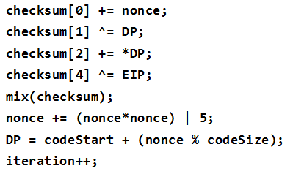
Simplified Self-Check Component
Self Check Looping Construct
“blocks”
Each block differs from the others so attacker will have to forge every block
Linear Sweeps

Slide 40
Self-Check “Pseudo-Random Walk”
Pseudo-Random based on Tick Session Nonce obtained from TPM
Iterates through the blocks a million times or so
Entire BIOS
Chronomancy range
is measured by the
self-check, including the portion that performs the linear sweep measurements
Self Check Looping Construct
Linear Sweeps

Slide 41
Linear Sweeps
Self Check Looping Construct
BIOS Chip
Measures BIOS, Option ROMs, SMRAM, IVT, and anything else you want.
Linear Sweeps
Linear Sweeps

Slide 42
Attackers Dilemma: 1 of 3
Attacker wants to implement a rootkit and of course wants to hide its presence.
Attacker is aware of BIOS Chronomancy and understands how to works.
Attacker knows if he does nothing the linear sweeps will detect his presence in the BIOS.
The timing measurement will be okay, but the calculated checksum will differ from the expected.
Self Check Looping Construct
BIOS Chip
>:(
Gotcha!
Linear Sweeps

Slide 43
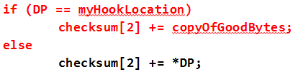
Attackers Dilemma: 2 of 3
Modifies the linear sweep code to hide his presence.
Turns out the penalty for modifying the linear sweep code is negligible.
Self Check Looping Construct
BIOS Chip
Conceal!
>:(
Linear Sweeps

Slide 44
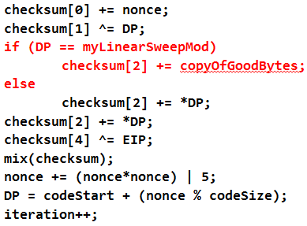
Attackers Dilemma: 3 of 3
However, now the attacker must also hide the changes he made to the linear sweep code from the self-check measurement.
Turns out the attacker suffers tremendous penalties when modifying the self-check.
Self Check Looping Construct
BIOS Chip
Conceal!
>:(
Linear Sweeps
Notes:
Nanoseconds can add up to significant runtime

Slide 45
Diff is ~4.8 ms. Attacker can win sometimes, as shown by measurement times that overlap.
Without attacker
With bare-minimal attacker
1 tick = 64 μs
Notes:
16900 ticks ~= 1.081sec
Diff = ~ (16975– 16900) * 64us = 4800us = 4.8ms (roughly), attacker can win
What causes the spikes?
We don't know yet actually. One speculation is that we're getting system management interrupts (SMI) during the measurement. Another is that given the extra instructions introduced by the attacker, we're occasionally hitting pathologically bad cases of caching behavior. Or it could be due to erratic behavior of the TPM. This coming fiscal year when we go through another round of self-check revision (when looking at attacks from peripherals), we are going to evaluate it with a fine-toothed performance monitor comb. We just learned about some useful built in x86 performance monitors from other work. They monitor things like cache hits/misses.

Slide 46
Diff is ~32 ms. Attacker does not win in this scenario.
Without attacker
With bare-minimal attacker
1 tick = 64 μs
Notes:
21072 ticks ~= 1.35sec
Diff = (21800– 21300) * 64us = 128000 us = ~32ms (attacker doesn’t win)

Slide 47
Diff is ~128 ms. Attacker does not win in this scenario.
Without attacker
With bare-minimal attacker
1 tick = 64 μs
Notes:
29744 ticks ~= 1.90sec
Diff = ~ (31750 – 29750) * 64us = 128000 us = 128 ms

Slide 48
TBA Summary
TBA was discussed briefly just to introduce you to one technique that can mitigate the weakness of a mutable CRTM
Is it perfect? Nope – and I’ll explain why in a sec
TBA code is open sourced for others to investigate if you feel inspired to experiment with it and improve it:
http://code.google.com/p/timing-attestation/
Timeline of other related work here:
http://bit.ly/11xEmlV
Of course the simplest fix would be to:
Implement the CRTM on a small, truly immutable, ROM
Provided the remainder of the chain of trust is measured properly

Slide 49
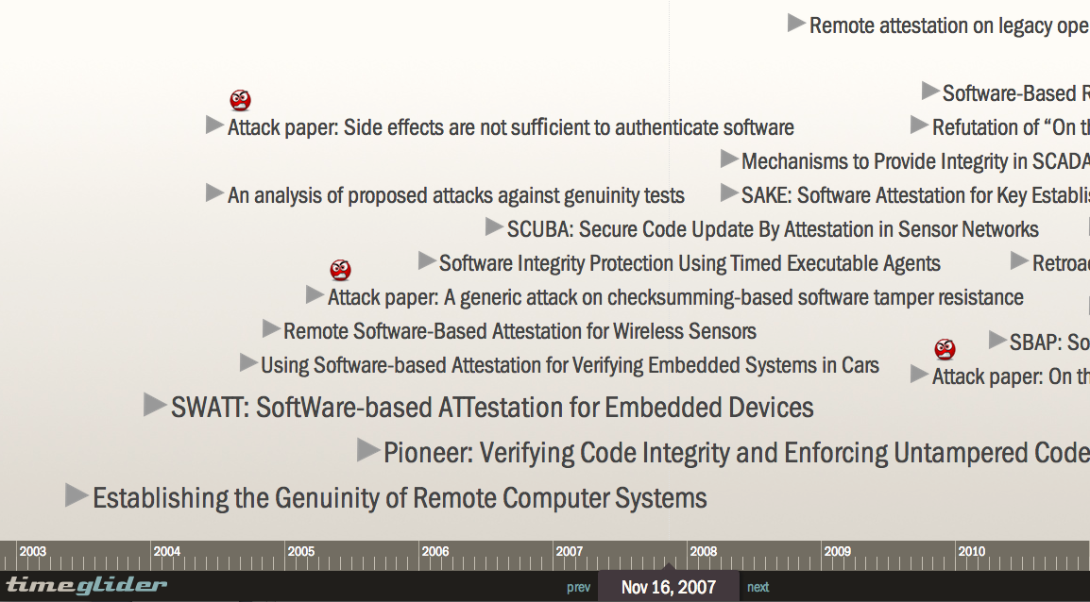
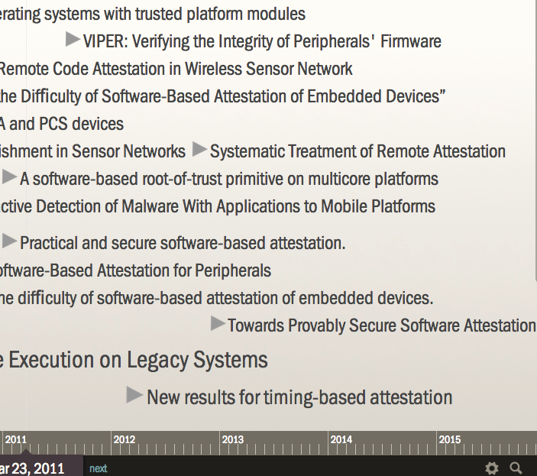
The past decade (available at http://bit.ly/11xEmlV)
Notes:
A decent number of papers, but not hundreds or anything. Predominantly published by CMU

Slide 50
TBA Problems: There are a few
Does not prevent a TOCTOU attack
The timer on the TPM must be reset to zero each time the system is reset
Provide a consistent “window of time” in which a good measurement was initiated
Otherwise the attacker could simply perform the measurement at a later time after having made the proper preparations
There is no trusted way to determine whether a measurement has been “skipped” due to platform reset before (or after) TBA execution (BIOS reset, etc.)
Still doesn’t solve the evil maid problem
Measurement will run while Evil Maid’s evil boot loader is installed, but after the evil maid resets the system and removes herself the next measurement will report a clean system

Slide 51
Measured Boot Early in Boot Process
One question about the measured boot process is regarding the question of ‘when’ it is to begin
Since the spec wants each boot component to be measured before execution control is handed off to it, it seems logical that the measured boot process should begin as early as possible in the boot process
Of course this is vendor-dependent as to when they start this process
I’ve observed that on the Dell E6400 that this process begins very “late” after “a lot” of code has already executed (chipset configuration, SMM instantiation, etc.)
I believe it should be done following the entry vector after the system has switched to protected mode
And not because “it’s better if it’s run early” since the flash is still mutable regardless…
My reason: because an analyst will be able to easily find the CRTM code and verify that it “looks right” without having to RE so much of the BIOS just to find it

Slide 52
Measured Boot Early in Boot Process
Technically, this is feasible because the TPM extends hashing functions to the BIOS and it is a memory-mapped device
So this is technically feasible:
Ensure TPM is mapped to memory (location is typically hard-coded in chipset)
Initialize the TPM itself and extend measurements to PCR0
As in accessing the memory-mapped BIOS, we’re not actually reading memory, we’re accessing a different device
Why isn’t this done? Probably because the BIOS flash and TPM are both very slow when compared to memory
And booting quickly is the most important thing in the world!
Vendors should at least provide the option for those who care and need it…it only has to measure a small amount of binary. (Ok I’m off my soap box now)

Slide 53
Better CRTMs coming down the pipe: Intel Boot Guard
Can’t say much on this at the moment (most docs under NDA, and haven’t evaluated it yet anyway)
Intel says "Hardware-based boot integrity protection that prevents unauthorized software and malware takeover of boot blocks critical to a system’s function, thus providing added level of platform security based on hardware."
Implements the CRTM notionally on the processor itself
Firmware boot block is measured/verified before the processor starts executing the SPI flash entry vector
Provides the following two basic functions
Measured Boot
Verified Boot
http://www.intel.com/content/dam/www/public/us/en/documents/product-briefs/4th-gen-core-family-mobile-brief.pdf

Slide 54
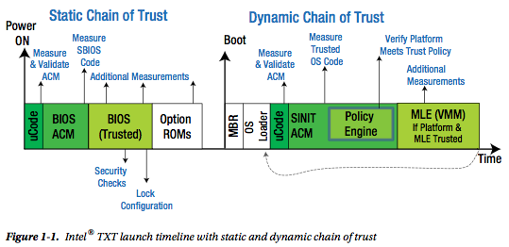
Better CRTMs coming down the pipe: Intel Boot Guard
It's effectively bringing to the client a superset of the way Intel Trusted Execution Technology (TXT) on Intel Xeon servers has apparently always worked: Running a TXT Authenticated Code Module (ACM) right from CPU reset
From "Intel Trusted Execution Technology for Server Platforms"

Slide 55
Better CRTMs coming down the pipe: HP Sure Start
New integrity & availability technology
Implemented in Embedded Controller (EC)
They say the EC starts from a true ROM, which would essentially be the S-CRTM for subsequent measurement of BIOS
Integrity: Checks a portion of the flash chip (likely only the boot block), and if it does not have the expected configuration, restores that portion from EC
Availability: If the integrity check fails, as it might if the chip was wiped to attempt to brick the BIOS, then this provides a non-attach-probes-to-the-SPI-chip recovery
We generally see this as a Good Thing™ , and we'd like to see more and more robust tech like this from other vendors

Slide 56
HP Sure Start
Supported models as of April 2014, according to an email to us from HP
Elitebook 820 G1
Elitebook 840 G1
EliteBook 850 G1
Zbook 15
Zbook 17
EliteBook Folio 1040 G1
EliteBook Revolve 810 G2

Slide 57
TPM and Bootkits
We have learned that signed firmware updates ensure that only an authorized BIOS can be installed to flash
However firmware signing won’t protect the system from a malicious boot loader, for example, which can be located on the hard disk
We know that the measured boot process can detect changes to critical boot components like the BIOS and MBR
But unless that detection is paired with something which provides protection (like Bitlocker or Secure Boot), a malicious MBR, for example, can still execute
Detection alone could be enough if your TPM is active and you are actively observing your PCRs
Few seem to be

Slide 58
TPM: Additional thoughts
You should activate your TPM in your BIOS
Flawed or not, it’s better than nothing ☹
Typically the BIOS will recognize automatically that the TPM is activated and you will get all the vendors measured boot functionality “for free”
Additionally you have to actually observe your PCRs for changes
Believe it or not, some people enable the TPM, check a box, and say “I’m secure now”
Your OEM *might* have a tool you can use to that effect; otherwise use OpenTPM

Slide 59
Another High-Level Problem: Untrusted Tools
So we’ve covered how the TPM CRTM may not really provide trustworthy information
But every tool we use to gather system information shares this problem
We’re relying on tools which have no means of attesting that the data we intended to read was in fact the data that was reported to us
We saw this in the Flea attack video where the PCRs were forged
We thought we were reading good BIOS, but in fact it was pure concentrated evil!
An attacker could either attack the tool itself or MitM the data as it’s being read by the application (via VMX for example)

